Slide 1
Future Tactical Management System
Week 3 - Client Meeting 1

Slide 2
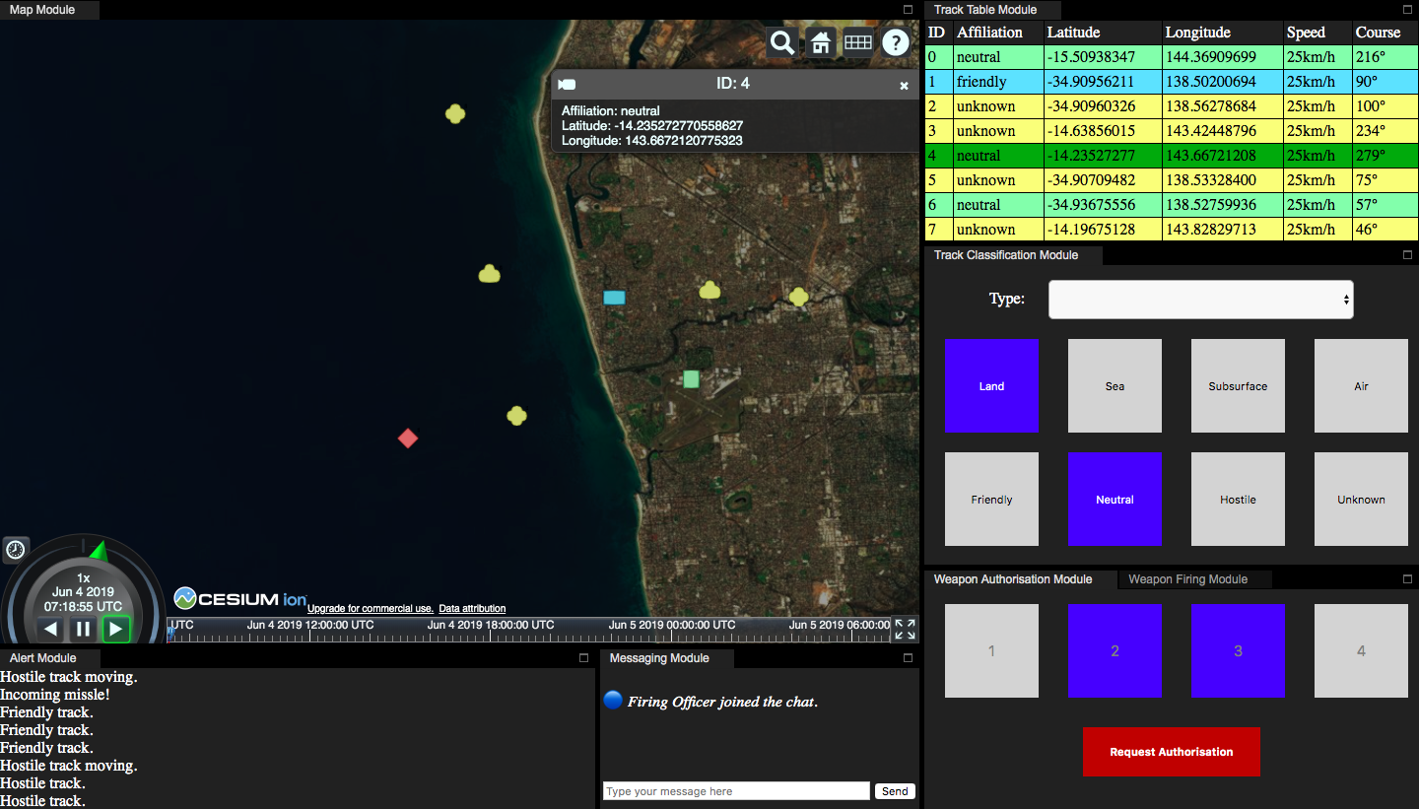
Semester 1 Recap: Prototype
Map module
Track table module
Track classification
Messaging module
Kafka streams

Slide 3
This Semester
Login system
Alerts from Kafka stream
Header bar
Ownship focus
Offline maps
Manual track adding
Track playback
Alerts
Weapon firing module
Weapon authorisation module
Authorisation approval module
Save window layout

Slide 4
Stretch Goals
User settings (light/dark themes)
Accessibility (colourblind mode)

Slide 5
By Next Meeting...
Login system
User Story: As an operator of the system, I only want to be able to access modules that are relevant to my role, so that I don’t do anything that I am not authorised to do.
Header bar
User Story: As an operator of the system, I want a logout button in the header bar, so that I am able to logout of the system easily.
Add alert stream to Kafka
User Story: As an operator of the system, I want to quickly notice new alerts so that I can promptly respond to them.

Slide 6
Minutes
What they want:
Gonna send json with alerts
Use existing technologies for login system
Header bar will have different functionalities
Logging in is a role based access control - more difficult
Logging out easily? More specific
Time out after a certain period of inactivity for security purposes. Turn it off (stretch goals)
Alerts - quickly? How? Research into an intuitive and effective manner
When you define user stories - allocate points based on how much effort u think it takes/requires to be implemented. 1-5.
Elaborate and break it down - be specific. If it is simple, is it worth it?
Alerts - multiple stories to implement what’s there. Can split more in some cases
Architectural things behind the system.
Stories are presented as user focus. Architectural design should be behind the scene - missing from last semester. Needs to be fixed and design it properly.
Offline maps - low quality. Still supports common formats, doesn’t look fantastic is not a big deal.
Which ones to approach first: alerts, - having it highlighted until acknowledged eg clicking it. Manual track adding is a big part, should support ownship focus but also snapping it and out of the modes.
Fixing things to further define user stories
Document user stories in wiki
Maintain github repository and organise the tasks - trebel? Linkhub? Define backlog items, allocate whos responsible for which task,
Questions - ask them
Testing
Ask for feedback from user stories on slack\
Scrum master and PO: up to u, switch it up (scrum master) clients r esesentially the PO.

